Slide 1
Working with git on your computer
Class 2 of 5
Welcome back.
Notes:
Welcome back to class!
Thank you to everyone who introduced yourself on the forum – I hope you’ve all had a chance to both introduce yourself and also read a bit about your classmates. There are actually 42 of you now.
We have a great group - we have systems librarians, archivists, web administrators, people with metadata expertise, lot of people that already work with git, some people who are making it a point to learn it to help in collaboration at work. Some people are interested in learning git to contribute back to open source projects, which is also really cool.
Something we’ve also learned from the survey (and thanks again to those who filled it out) is that there is a wide range of experience and knowledge in git. Some people seem fairly experienced, others not as much. We also learned that more people than not wanted to spent class time learning command line. There is a handful of people who didn’t want to spend class time on that – and that’s totally understandable – so what we are going to do is in a moment I am going to let Heather spend about 10 – 20 minutes talking about command line, showing you a demo. For more resources, I’ve put up a few links on our page (see Moodle)
And while we’re on Moodle – I want to remind you again about our office hours. No one came to either mine or Heather’s! So you might remember from last week – we asked you to install git. Did everyone do this? Is it possible that everyone was able to install git and no one had problems? That would be be awesome but it doesn’t sound realistic. You don’t have to come to office hours, of course, but we want to make sure – did anyone try to attend but wasn’t able? Let us know. Also, you can post to the forum and email us.
But as a reminder our office hour info will always be here on this Moodle page.
Also – on our survey we asked people what their operating systems were – I’m interested in hearing from the people who were running Linux RedHat & Ubuntu – did your git install go smoothly? Let us know.

Slide 2
Working with git on your computer
An overview of general commands
Git commands in context of using git
How do I undo something?
Git concepts: commit, HEAD, branch
Gitignore (post-class note: we did not get to this in this class)
Notes:
Today we will be talking about using git on your computer. I know a lot of you are interested in talking about branching and merging – we may get to that today – at least to an introduction in branching – but I want to make sure we have the very basics of using git down first, and trust me, I find branching & merging incredibly important feature of git so we will definitely be spending time on it, that’s why I do want to spend a whole class on it later, but it is something that we may need to touch on for the basics.
Heather will go over some general command line stuff, then I will talk about some basic, very important git commands within the context of working on a project – and the next things just really matter about the time – but we’ll talk about how to undo things, which leads us to some concepts to start/continue building up a understanding for. And if there’s time we’ll talk about git ignore (UPDATE: there was no time). For next week, we’ll have you set up a project on your local computer and track it with git. There will be more instructions at the end.

Slide 3
Git Bash
Is a shell
Similar to Mac Terminal or Windows Command Line
Allows both git commands and linux-based commands
Notes:
We’re using Git Bash on PC to more easily work with git on the command line. Otherwise, some of the commands we’ll talk about may not work on the Windows Command prompt.
Git Bash is a shell. A shell is a program that interprets the commands a user enters and then interacts with the operating system based on those commands.

Slide 4
Commands
pwd
ls, ls -al
Documentation tip
Git Bash: <command> --help
Terminal or Linux: man <command> q to exit
Notes:
DEMO: look to video at minutes 7:34 – 13:40

Slide 5
Common commands: creating files & directories and navigation
mkdir
cd
touch
cp
mv -> rename and move
Notes:
DEMO: look to video at minutes 13:57 – 20:40

Slide 6
Common commands: removing files & directories
rm
Rmdir
rm -r
Notes:
DEMO: look to video at minutes 20:54 – 24:34

Slide 7
Common commands: misc & shortcuts
clear
cat
cd ~ (home directory)
Past commands: arrow keys, history !<#>
Tab completion of file names
Ctrl + C
Notes:
DEMO: look to video at minutes 24:58 – 29:53

Slide 8
Git Commands you will see
Common commands:
git status, git add ., git commit, git log
Commands for configuring project:
Git init, git config, git remote add
Notes:
These are the commands we’ll look at today. I’ve put them on this slide and the next, and besides some more advanced ones these are mostly the only commands you’ll have to use, and the only commands you’ll have to use for this class, I’m sure.
The best way to know about these commands is to understand what they are for and when to use them, but it’s not like you have to memorize them – you can always google to see how to do things, but again, we’re just building up your understanding here.
I’m not going to go over all these commands today – I’m going to walk you through some common commands on a demo,.
And for the practice we’ll have you do before next week, we’ll only have you practice the ones that I demo today. And, also, there are git command resources on the same page that I showed you the command line resources – including a cheat sheet that some people may want to print for handy reference. One of the reasons that I wanted to organize the commands in this way is that if you look at the cheat sheet or other git command references, they are going to mention things like git clone, push, pull, etc, and you may wonder why we haven’t talked about them yet – really, it’s not about building up to using them, it’s just about how we’re arranging this class.
---
Git status – I put git status first because you will be using this command all the time. Remember that git runs in the background, especially if you are using command line, so this will be your way to check in with git – you’re asking, if git sees any changes.
-Git add – this stages the file, tells git you intend to commit the file. Git commit is the command you use to make a commit, and remember that this comes with a message to yourself, I will go over how to do that. And remember that a commit is a snapshot, a version of the project. And it takes a snapshot of all the files at that place in time, and you can go back to this version. This version is called a commit. So commit is both an action, and a place in time to go back to. You’ll get more used to this as we use git more.
Git log is the command to show you your history – all those previous commits that you or another developer made.
This next set of commands (commands for configuring the project) – you won’t use them as much, maybe once per project. If you pull a project down from GitHub or something similar, they will already be set for you.
See video at 33:12 – 37:20 for demo of these commands

Slide 9
Git Commands you will see
Commands we’ll work with with branches and moving back through commits
Git branch, git checkout, git merge, git reset, git diff
Commands for working with GitHub/external repos
Git clone, git push, git pull, git fetch, git stash, git pop, git tag, git remote -v
Notes:
(we will look at these commands in future classes – although some of them, like git stash, pop, and tag we may not have time for)

Slide 10
Vim, Nano & Emacs
Text editors in the command line
You may run into these as you use git

Slide 11
Vim
Common commands:
i = insert
Escape -> gets you out of input mode
:q = quit
:w = write/save
Notes:
Use these commands to work with Vim. (see Demo at )
While it’s true that an easy way to avoid using vim is to use the –m flag on commit, but you will also see it in the future when you are dealing with merging. Also, I’ve been using sublime to open up and edit my documents on the command line, but I had to set that up through a symlink on my computer – if you don’t have a text editor set up to do this, you may have to use vim to do quick edits. This is especially true if you are working on remote servers that don’t have a user interface besides the command line. It’s worth getting used to using this type of text editor – its not a git thing, it’s a command line thing. Some similar text editors are Nano and Emacs. They use different commands – highly google-able when you are confronted with something like that.

Slide 12
How do I go back to an earlier commit?
Revert:
Git reset hash
Safely look at an old commit:
Git checkout hash
Notes:
Aka version/snap shot
What happens if you make a change that you actually don’t want to commit. If you want to revert back to an earlier version, you can do this by using the reset command.
If you just want to simply look back on something, and not lose the project history that you have so far, you would need to checkout a commit. This is basically making a branch of your project – so before I talk about this, I want to talk a bit more about what a branch is. For now, let’s just talking about reverting. You’ve made an error, or you just want to start all over again. The way to do this is to reset.

Slide 13
How do I go back to an earlier commit?
Git reset HEAD
Git reset HEAD --hard
Notes:
The most common way to do this is to reset the HEAD. Remember that HEAD is the most recent commit. So let’s say you made a change. And you just want to go back to the most recent commit.
Look at video for demo at: 45:35 -48:30. Also, Kate made a mistake in this portion of the video – can you spot it? If so post to the forum.

Slide 14
How do I go back to an earlier commit?
When you want to go back to a commit before the last one:
Git reset HEAD~1 --hard
Notes:
You generally only reset your commits to HEAD or 1 before HEAD. If some change you’ve made is deep within your project history, it’s just best to go to those files, make a change, and commit. You don’t want to lose all that stuff in between, unless there is something seriously wrong.
So this is one way to go back, but really git is much more flexible when you are using branches to either look back at earlier work, or start a new feature that might get complicated. So, let’s just review some concepts before we talk about branches more – and lets get a brief introduction to what branches are.

Slide 15
Git Concepts
A Commit
HEAD
Branches

Slide 16
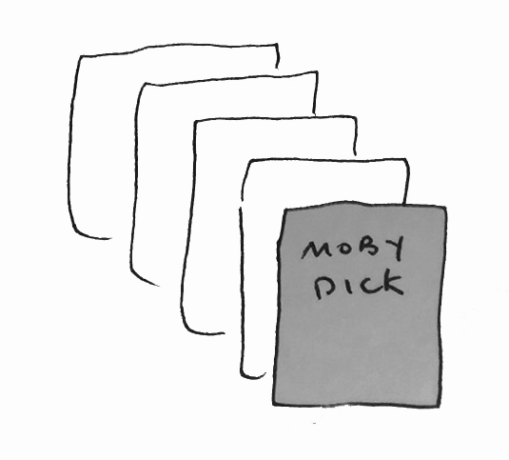
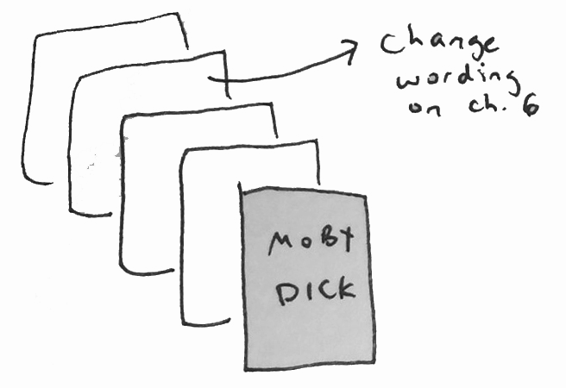
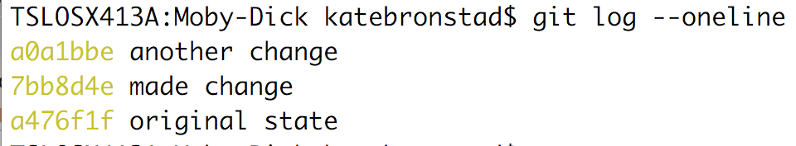
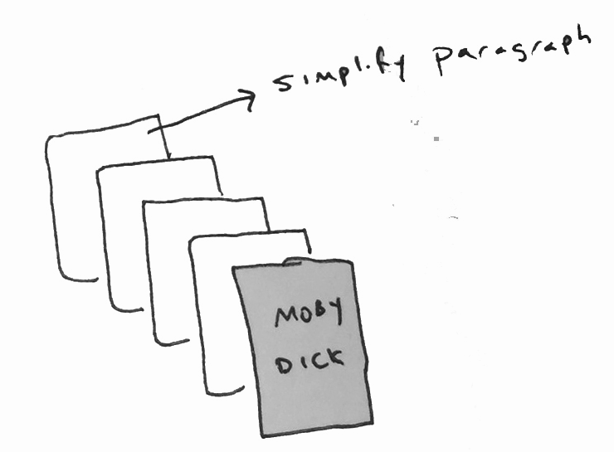
Git Concepts: Commits
Commits
Notes:
Review of commits: Each commit is a version of your project. We can go back to this commit and see how all the files looked at this point in time.

Slide 17
Git Concepts: HEAD
HEAD
Notes:
HEAD is a reference/nickname for the most recent commit (instead of referring to the commit by it’s unique hash, we can refer to it by just typing HEAD)

Slide 18
Git Concepts: HEAD
Git reset HEAD~1 --hard or Git reset 7bb8d4e --hard
Notes:
We can move HEAD by resetting it to a previous commit. You can use the unique has to refer to this previous HASH or just say “HEAD~1”. Unless you have a really good reason, you don’t want to reset past more than 1 commit, because that complicates the project history.

Slide 19
Git Concepts: HEAD
HEAD
Notes:
Illustration of how when we reset the HEAD, HEAD now points to what was once the 2nd most recent commit. Everything in the previous commit has been deleted (so, caution using this!)

Slide 20
Git Concepts: Branches
We start with a default branch: master.
Notes:
Whenever we initialize a git project, we’re automatically on a branch called master.

Slide 21
Git Concepts: Branches
Master branch
New branch: another_moby_dick
Git branch another_moby_dick
Git checkout another_moby_dick
OR
Git checkout -b another_moby_dick
Notes:
We can create new branches. Branches are essentially a copy of the branch we are currently on. So if we were to make a branch on master, we would have a branch that’s an exact copy. We can move to this branch by using the command “checkout”. Once we are on the new branch, we can do new work. Master will not have this new work unless we merge the branch over.

Slide 22
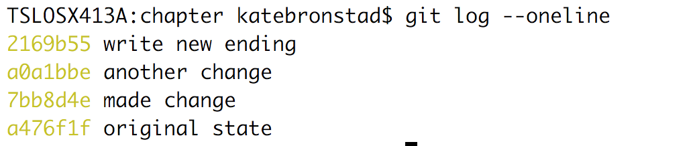
Git Concepts: Branches
Master branch
New branch: another_moby_dick
Notes:
The great thing about branches is that you can do very experimental work and not have to worry about messing up the work you’ve already done; working with git helps with this anyway, but this is even more helpful when you are collaborating with someone. You don’t have to worry about your experimental work merging into the project until you are ready. It gives you a safe space to develop and test your code.

Slide 23
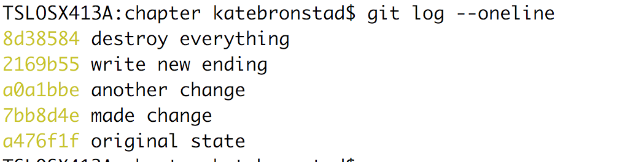
Git Concepts: Branches
Master branch
New branch: another_moby_dick
Notes:
If you are unhappy with your code, you can always delete this branch and start again.

Slide 24
Git Concepts: Branches
Create a branch to look back at earlier commits
Master branch
New branch: earlier_version
Git checkout -b earlier_version
Git reset a475f1f --hard
Notes:
In the context of what we talked about earlier, about looking back at an earlier commit in your project history, branches are the safest way to look back at code in an earlier commit. To do this, you would checkout a new branch (the command git checkout –b new_branch_name both creates a branch and checks it out at the same time). Then you can reset the HEAD to the earlier commit and have a look at the code.
You’ll get rid of the project history in between – BUT all that is still available in the master branch.
There are ways to checkout a file from an earlier commit and we can show you that later.

Slide 25
Gitignore
A file, not a command
Git Ignore files you don’t want to track
privacy: user information, confidential information, including config files
Files used in only in local development or that get installed by package managers (ex. NPM, bower)
Images
Notes:
NOTE: We did not get to .gitignore in class and will talk about this in a later class.

Slide 26
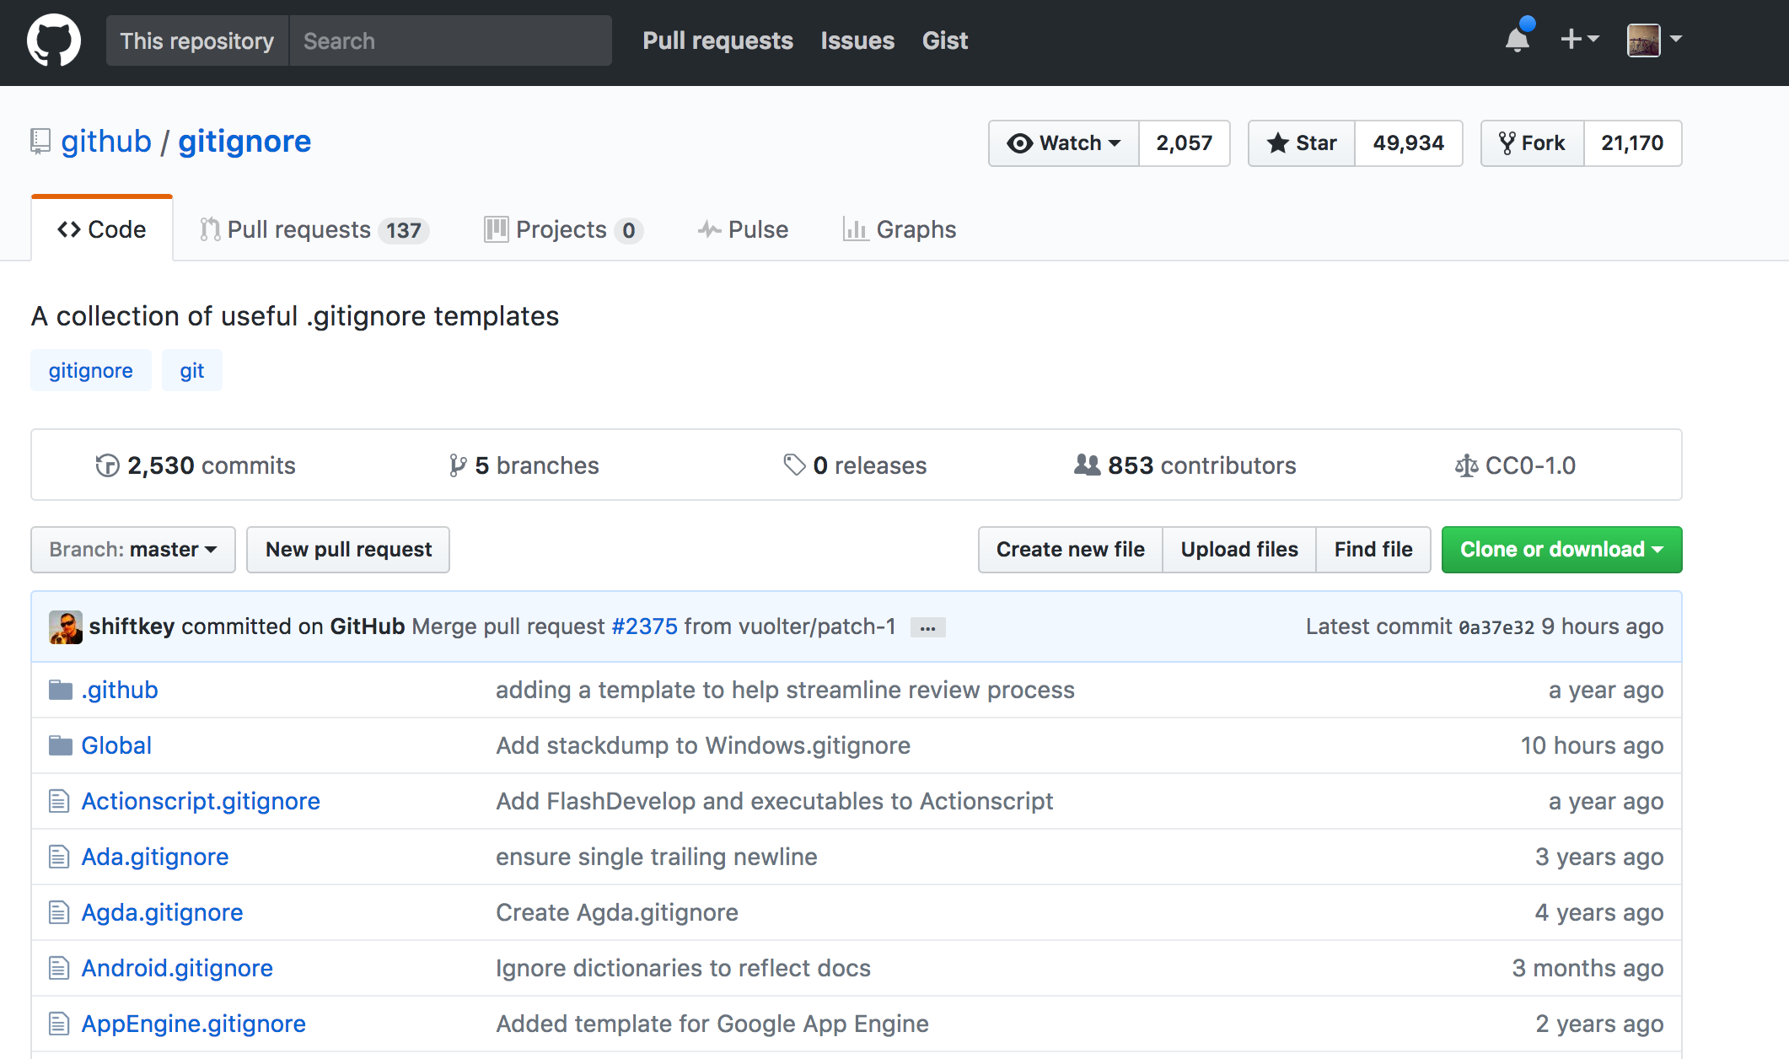
Gitignore

Slide 27
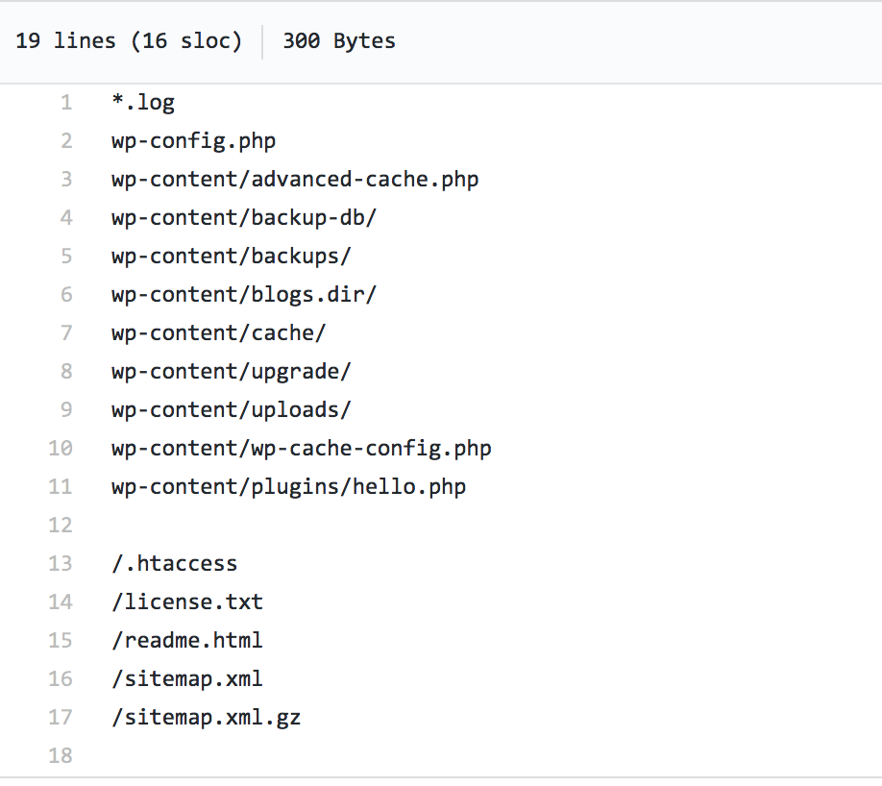
Example Gitignore file
WordPress .gitignore

Slide 28
For next week
Set up a directory using command line
Add multiple files. Make a commit with multiple files. Edit the files and add a commit.
Revert back to an earlier stage

Slide 29
For next week: advanced
Make a gitignore file that ignores images.
Test by putting images in your project & running git status to see if git tries to track them.

Slide 30
Next week: GitHub
Preview GitHub
Set up account
Connect your computer with GitHub

